Slide 1



MARCH 17 2025
Hosted MLFlow Alternatives
Contributor
Richard Buckley
Contributor
Jarrett Defreitas

Slide 2
MLFlow: Explained
The Problem
Finding a Solution
When training AI models, especially on compute clusters, how can we (easily) keep track of our training statistics?
>> One solution to this alternative is MLFlow.
Training AI Models

Slide 3
MLFlow: Explained
How it Works
Training AI Models
MLFlow Server
Web Browser
Jupyter Notebook,
Python Environment,
etc.
A (generally) separately hosted server, which keeps track of statistics
Login to the MLFlow server in order to view the statistics reported by the training process

Slide 4
MLFlow: Explained
The Problem (contd.)
Finding a Solution
MLFlow is great, but, without working as part of a company, where can we host the server?
>> Hosted MLFlow Alternatives
Training AI Models

Slide 5

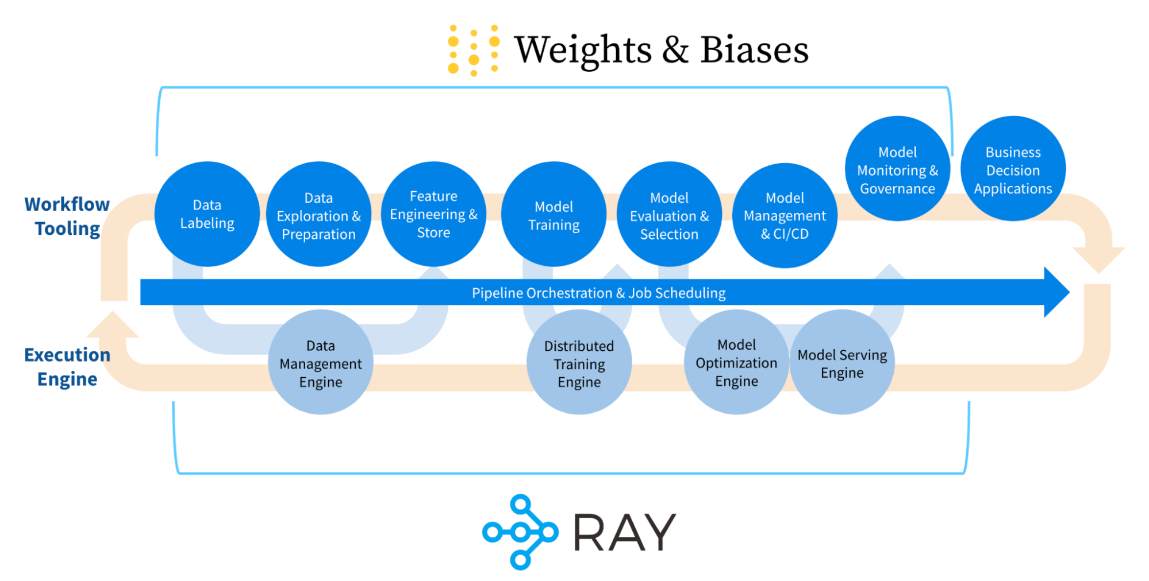
wandb.com
Weights & Biases
Free for Academia
Allows companies to privately host

Slide 6

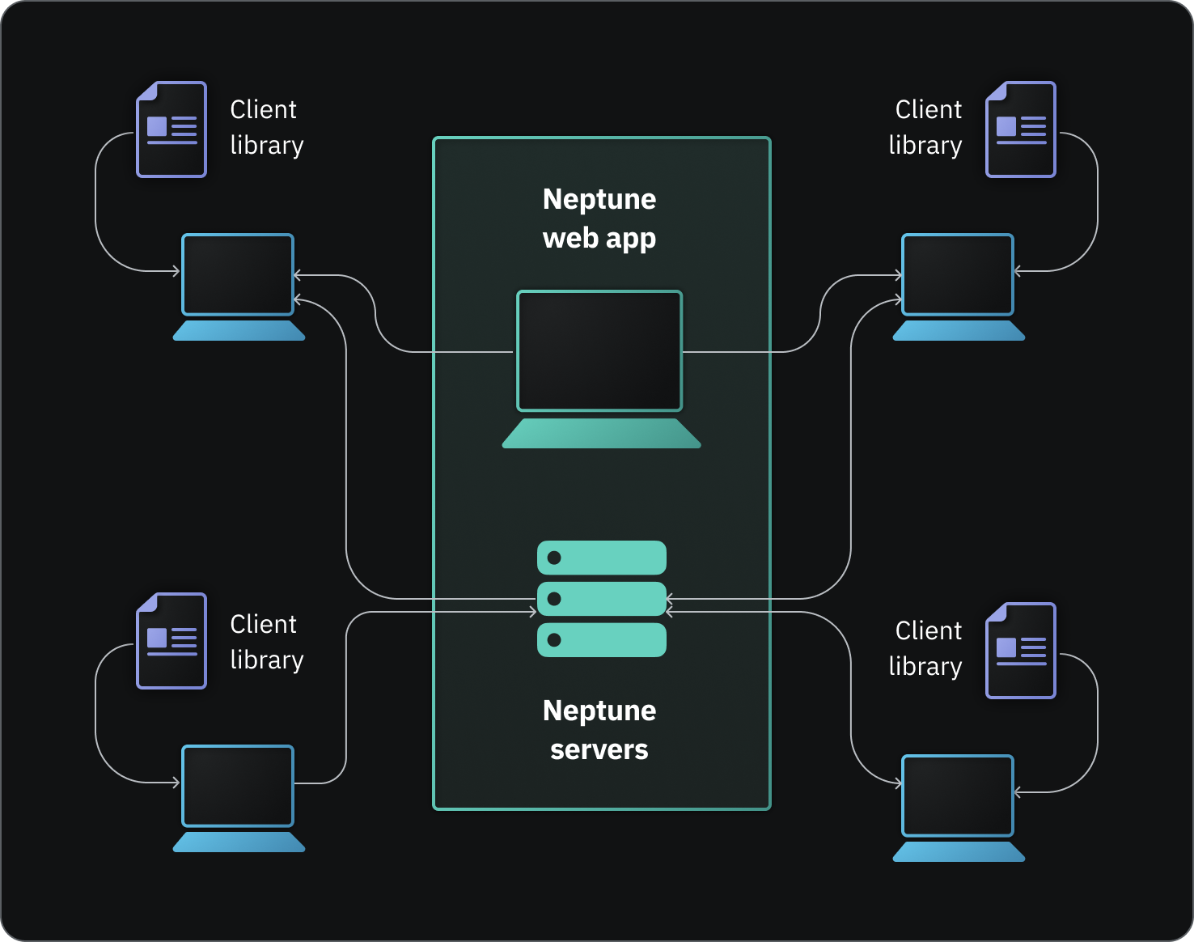
neptune.ai
Neptune.ai
Free for Academia
Allows companies to privately host

Slide 7

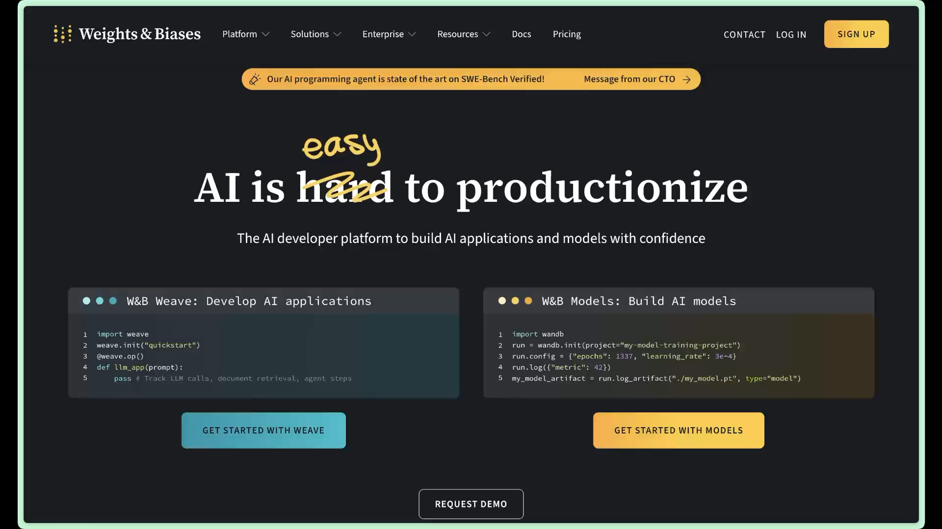
Getting Started: Create an Account
wandb.com
Logging In
Goto https://wandb.com
Select Sign Up
Create your account.
Getting your API Token
User Icon > User Settings
Scroll down to API keys
Click Reveal
Applying for Free Access
User Icon > Billing
Apply for Free Access
Add .edu email address (if not already using)
Fill out and submit form.

Slide 8


Example: Hosted MLFlow In Practice
Jupyter Example
your task
Navigate to the course GitHub, and clone the notebook titled workshop_mflow_alt.ipynb.
Photo taken from Silicon Valley TV Show

Slide 9

Workshop: Application
Create something
create something new
Modify a past assignment in order to use this technology. Pick something that will converge quickly.
Challenge: Use Unity
This Photo by Unknown Author is licensed under CC BY-NC

Slide 10
Any Questions?

